Slide 1
Unit 5 For Live Session Assignment
Isabella Westlauer
2/1/2026

Slide 2
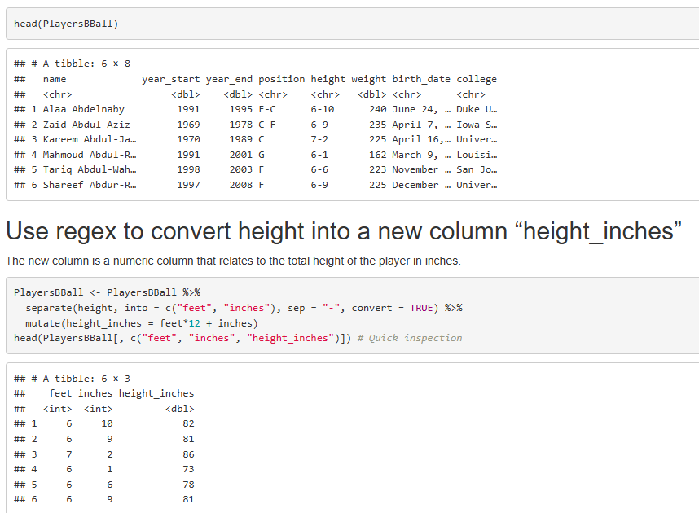
NBA Players Height Format Using Regex
I could have also converted inches to a fraction of a foot and represented the height as the total feet. Why would one be preferable over another?
Notes:
We previously used a dataset called PlayerBBall.csv which contained information about NBA basketball players. To finish that assignment, you had to manipulate the height column.
Review the code you used to do that and see if you can’t make more efficient code using regular expressions and / or the string functions from this Unit.

Slide 3
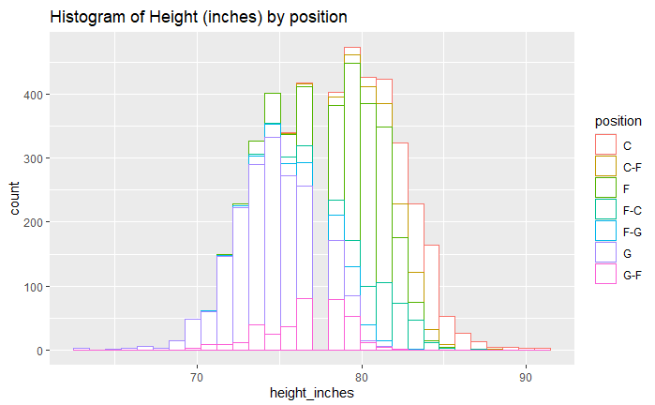
Notes:
Use this variable to make a chart that contains histograms of heights for every position (color coded).

Slide 4
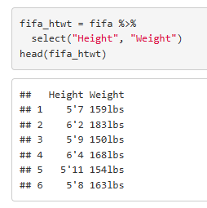
Height vs Weight of FIFA Players
First, I looked at the data to see that I need to separate the feet and inches of Height column by the single apostrophe, and replace the ‘lbs’ in the Weight column
Notes:
We previously used a dataset called FIFA Players.csv which contained information about Soccer players.
Use the string functions and regular expressions to assess a relationship between height and weight among soccer players. To do this you will need to manipulate the height and weight columns into columns that have numeric values of the height and weight. Tell your story using 2 – 4 PPT Slides.

Slide 5
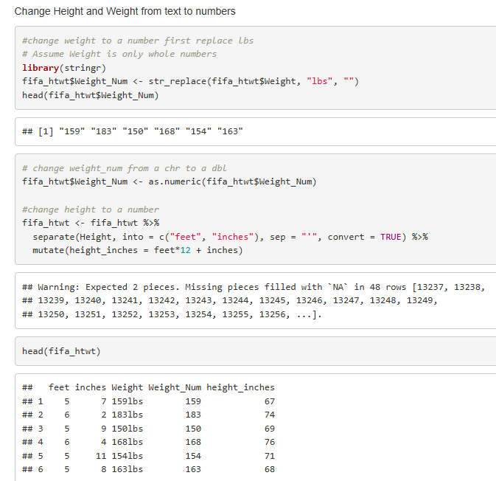
Height vs Weight of FIFA Players
I used the stringr library, and first replaced the substring “lbs” in the weight column with “” which removed it.
I separated the height into feet and inches columns, then used a formula to calculate total inches.
I then changed the data type of weight and height to numeric
Was I supposed to remove NA first?
Notes:
We previously used a dataset called FIFA Players.csv which contained information about Soccer players.
Use the string functions and regular expressions to assess a relationship between height and weight among soccer players. To do this you will need to manipulate the height and weight columns into columns that have numeric values of the height and weight. Tell your story using 2 – 4 PPT Slides.

Slide 6
Height vs Weight of FIFA Players
Before
After
Notes:
We previously used a dataset called FIFA Players.csv which contained information about Soccer players.
Use the string functions and regular expressions to assess a relationship between height and weight among soccer players. To do this you will need to manipulate the height and weight columns into columns that have numeric values of the height and weight. Tell your story using 2 – 4 PPT Slides.

Slide 7
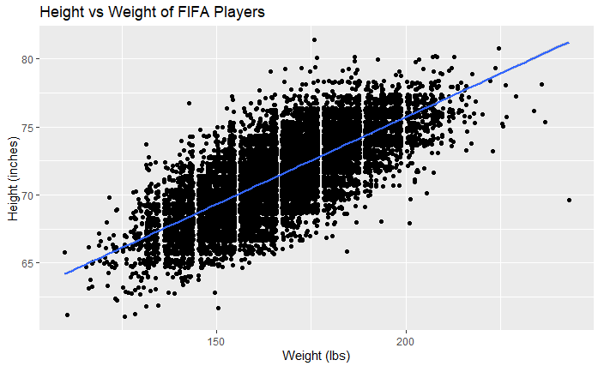
Height vs Weight of FIFA Players
There is a clear correlation between the height and weight, with several outliers.
Notes:
We previously used a dataset called FIFA Players.csv which contained information about Soccer players.
Use the string functions and regular expressions to assess a relationship between height and weight among soccer players. To do this you will need to manipulate the height and weight columns into columns that have numeric values of the height and weight. Tell your story using 2 – 4 PPT Slides.

Slide 8
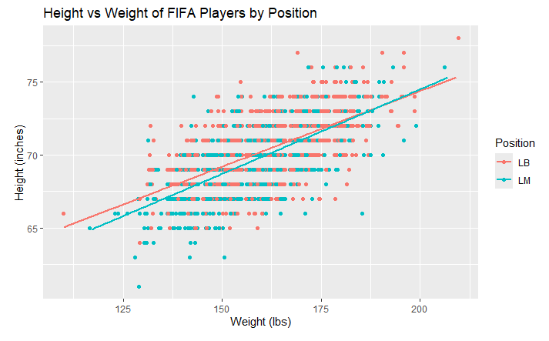
Height vs Weight Relationship by Position
The height vs weight of LB and LM appear to have almost the same correlation.
Notes:
Next, assess this relationship between just the LB and LM positions. (1 slide should do it.)

Slide 9
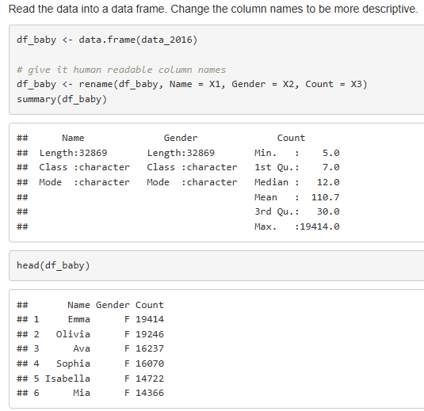
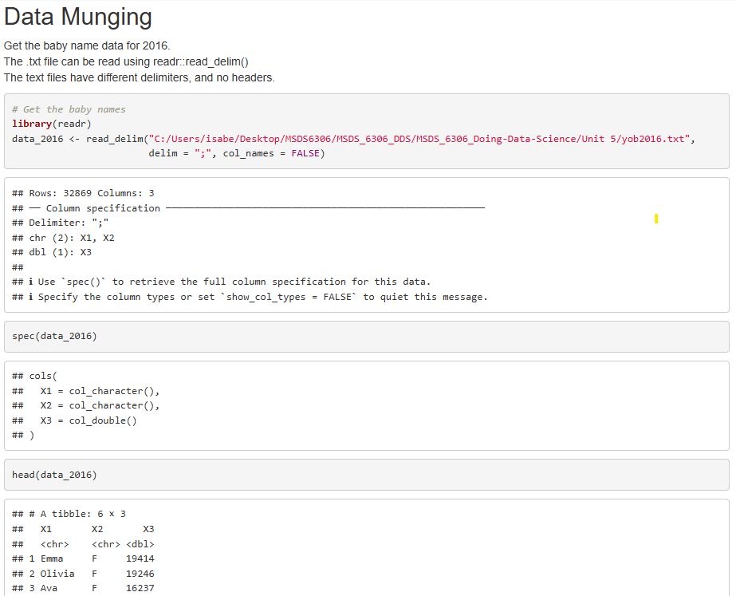
Data Munging
I found the delimiter in the .txt file was a comma, used spec() to see the column specifications, then viewed a summary of the data. For characters, I see there are 32,869 names in the first column, and for the count, I see it ranges from 5 to 19,414. I renamed the columns because there were no headers in the .txt file. The head() seems to show the data is already in order of decreasing count, with the most popular names at the top.
Notes:
Data Munging (30 points): Utilize yob2016.txt for this question. This file is a series of popular children’s names born in the year 2016 in the United States. It consists of three columns with a first name, a gender, and the amount of children given that name. However, the data is raw and will need cleaning to make it tidy and usable.
First, import the .txt file into R so you can process it. Keep in mind this is not a CSV file. You might have to open the file to see what you’re dealing with. Assign the resulting data frame to an object, df, that consists of three columns with human-readable column names for each.
Display the summary and structure of df

Slide 10
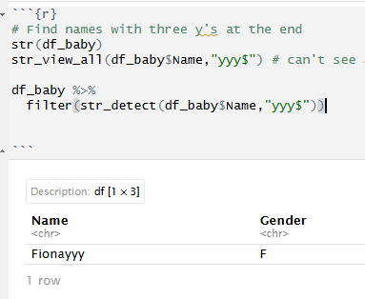
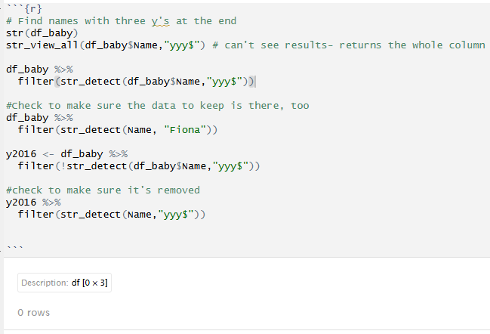
Data Munging
I used str_view_all with the regex “yyy$” to find three y’s at the end of a name. I couldn’t see all the results because the whole Name column was returned, so I used filter() and found the name. Then I wanted to check that the Gender and Count matched “Fiona” before deleting the row with Fionayyy. Finally, I removed the misspelled name.
Notes:
Your client tells you that there is a problem with the raw file. One name was entered twice and misspelled. The client cannot remember which name it is; there are thousands he saw! But he did mention he accidentally put three y’s at the end of the name. Write an R command to figure out which name it is and display it.
Upon finding the misspelled name, please remove this particular observation, as the client says it’s redundant. Save the remaining dataset as an object: y2016

Slide 11
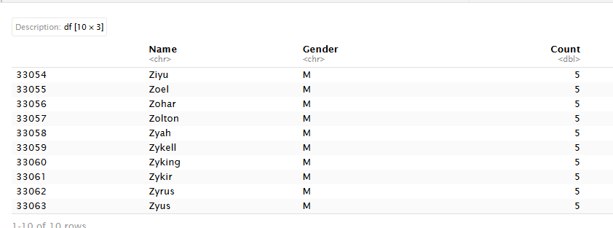
Data Merging
These are very unusual names. They are all Male names starting with Z, and the count is 5 for each. Maybe that’s because the dataframe was already sorted by Count, or by Name?
Notes:
2. Data Merging (30 points): Utilize yob2015.txt for this question. This file is similar to yob2016, but contains names, gender, and total children given that name for the year 2015.
Like 1a, please import the .txt file into R. Look at the file before you do. You might have to change some options to import it properly. Again, please give the dataframe human-readable column names. Assign the dataframe to y2015.
Display the last ten rows in the dataframe. Describe something you find interesting about these 10 rows.

Slide 12
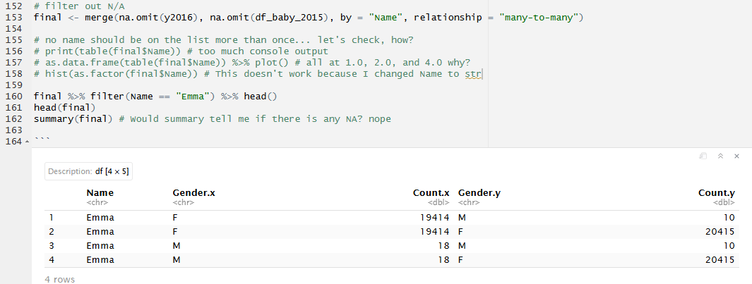
Male Emmas?
The data shows there were 18 male Emmas in 2016, 10 male Emmas in 2015. So, I have to merge the datasets from 2015 and 2016 on both Name and Gender.
Notes:
Merge y2016 and y2015 by your Name column; assign it to final. The client only cares about names that have data for both 2016 and 2015; there should be no NA values in either of your amount of children rows after merging.
We should not merge the data sets by Name only because some names are both Male and Female. We can merge on both Name and Gender, or we can group by Name, regardless of gender to get the name and count before (or after) merging 2015 and 2016.

Slide 13
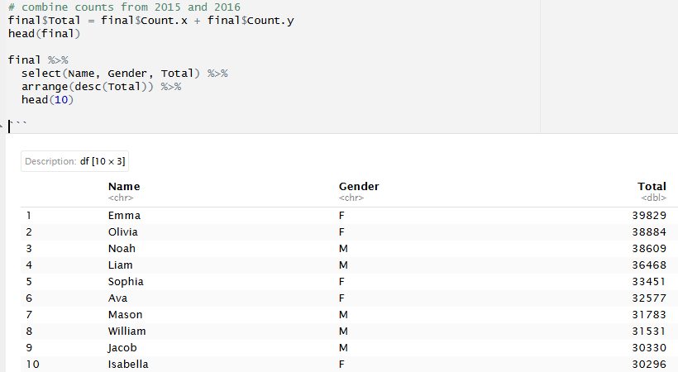
Data Summary – 10 Most Popular Names
These are the top 10 most popular names from 2015 to 2016.
How many people were given popular names? To answer this, maybe we should sum the totals of all the names in the first quartile.
Notes:
3. Data Summary (30 points): Utilize your data frame object final for this part.
Create a new column called “Total” in final that adds the amount of children in 2015 and 2016 together. In those two years combined, how many people were given popular names?
Sort the data by Total. What are the top 10 most popular names?

Slide 14
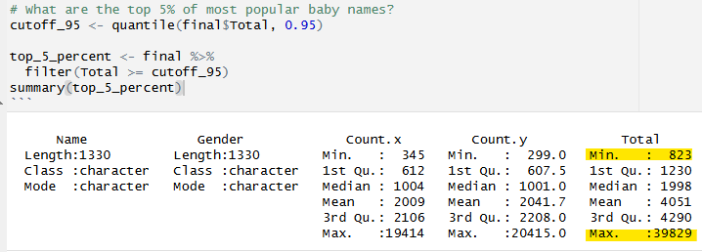
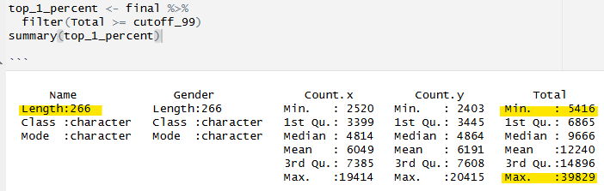
Get the Top 5% and Top 1% Most Popular Names
Top 5%: There are 1,330 names that have a total at least 823.
Top 1%: There are 266 names that have a total at least 5416.

Slide 15
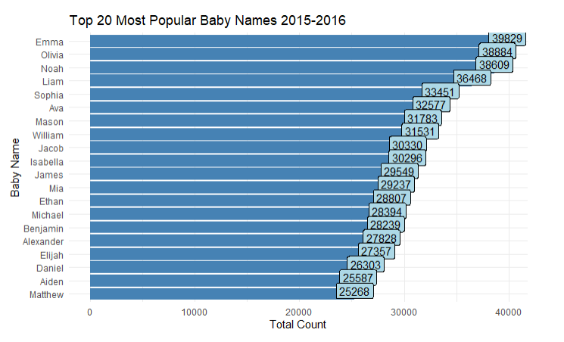
These are the top 20 baby names from slicing the top 1% of popular names. There are 266 names in the top 1%, so I used arrange(desc(Total)) and slice_head(n=20) to get the top 20 names.
Notes:
Alt H G A C
Alt H G A M

Slide 16
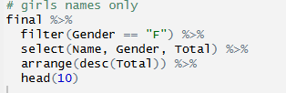
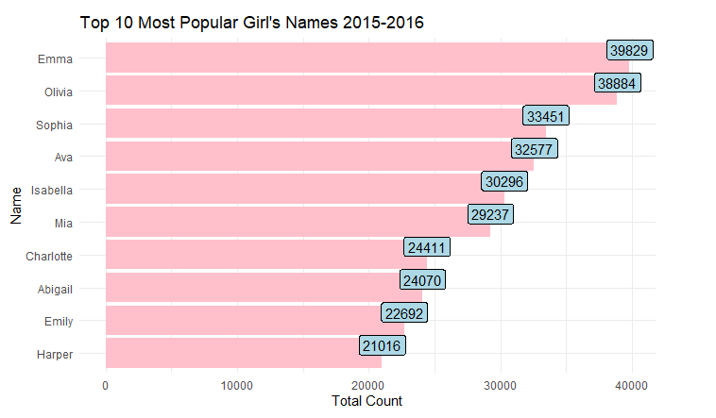
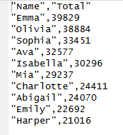
Data Summary – 10 Most Popular Girl’s Names
Notes:
3. Data Summary (30 points): Utilize your data frame object final for this part.
The client is expecting a girl! Omit boys and give the top 10 most popular girl’s names.
Write these top 10 girl names and their Totals to a CSV file. Leave out the other columns entirely.

Slide 17
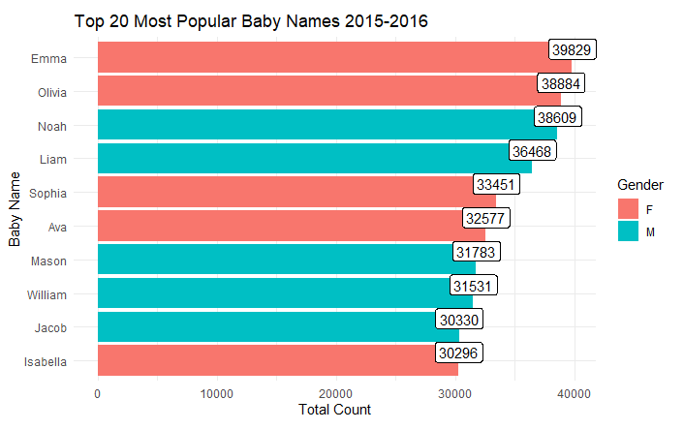
Baby Names Study
From 2015 to 2016, the most popular baby name was Emma. For boys, the most popular name was Noah.
Some of the least popular names, like Ziyu, Zohar and Zyking, were even more uncommon than Emma was among boys’ names.
Notes:
4. Data Visualization: Create a well labeled, visually appealing and informative visualization summarizing some of the results of this study.

Slide 18
Takeaways and questions!
After I selected the Height and Weight of FIFA players, and added new columns to represent them as numbers, I wanted to plot by Position. But I had preemptively removed that column. Should I not have used a select() statement? Should I have thought ahead before selecting columns to keep?
Full markdown here: https://github.com/Iwestlauer/doing_data_science/tree/main/Unit%205%20Relational%20Data%20and%20Regex
Notes:
Takeaways
and
questions!

